Slide 1



UNIT 2: Home is where heart is
Home sweet home

Slide 2
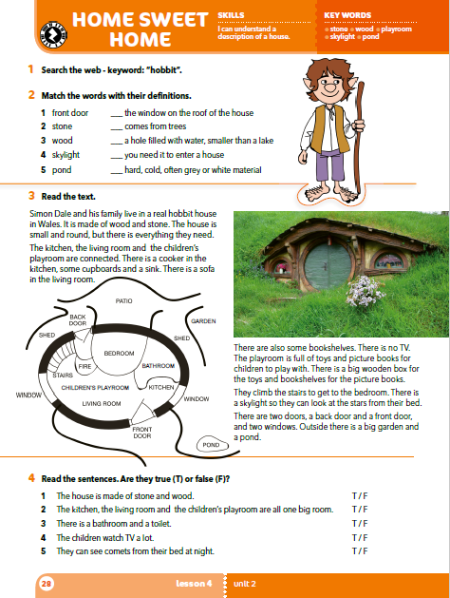
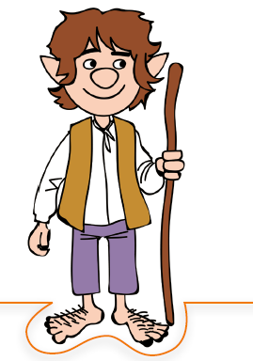
Do you know what a hobbit is?
Describe the hobbit in the picture.
Do you know any books or films in which there are hobbits?
What’s the name of the most famous hobbit?
Bilbo Baggins

Slide 3
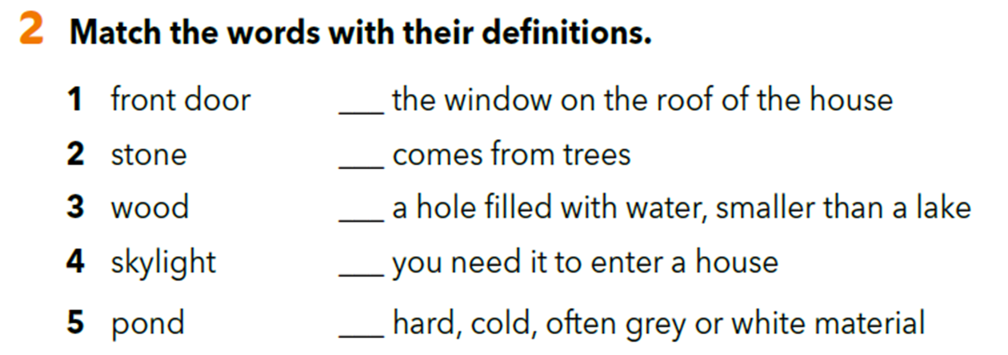
4
3
5
1
2

Slide 4
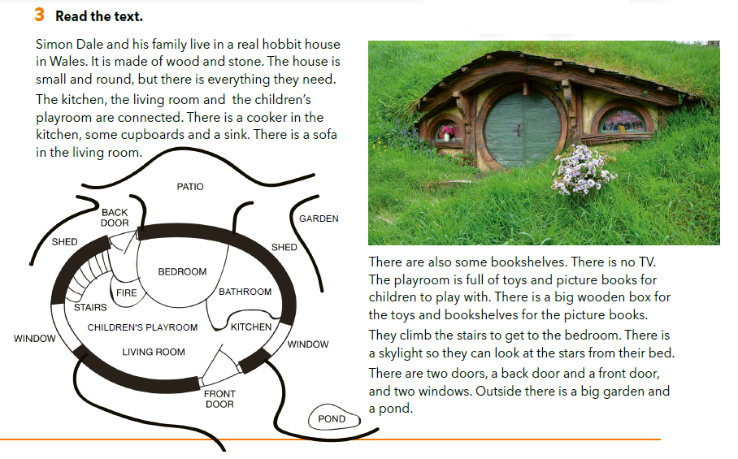
Describe the photo and the floor plan next to the text.

Slide 5
Translate. window – fire –
shed – children’s playroom – back door – patio –
garden – stairs –
prozor
oganj
spremište
dječja igraonica
stražnji ulaz
otvoreno dvorište
vrt
stepenice

Slide 6
Skim the text and answer the questions.
Who lives in a hobbit house?
Where is it?
How many floors are there in the house?

Slide 7
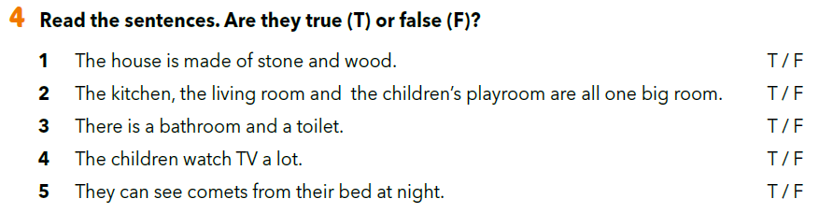
Read the text aloud. You can read it in different voices (e.g. as if you were a mouse, a big bear, very scared…).

Slide 8
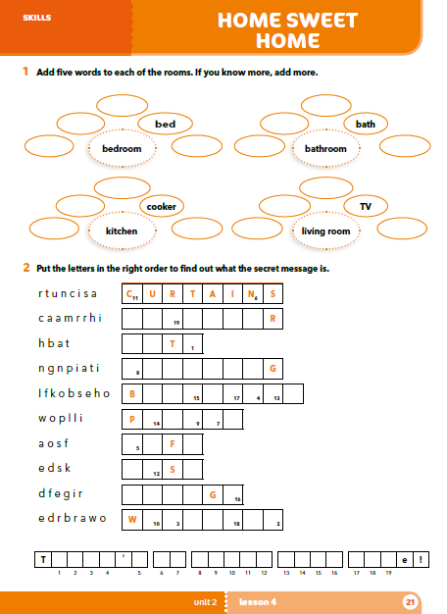
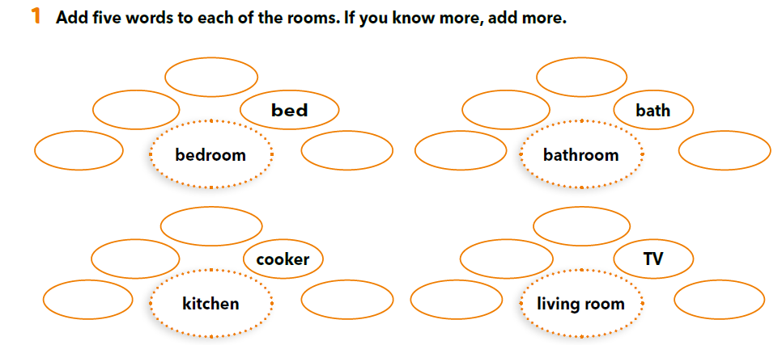
Possible answers.
desk
mirror
wardrobe
washbasin
pillow
carpet
shower
tap
drawer
carpet
fridge
armchair
sink
cupboard
sofa
painting

Slide 9
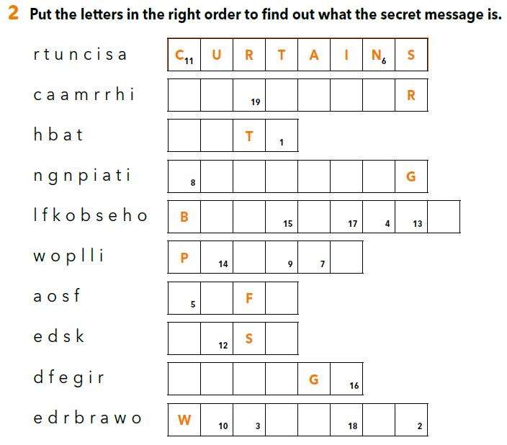
A R M C H A I
B A H
P A I N T I N
h e r e s n o p l a c e l i k e h o m
O O K S H E L F
I L L O W
The secret message is:
THERE IS NO PLACE LIKE HOME!
S O A
D E K
F R I D E
A R D R O B E

Slide 10
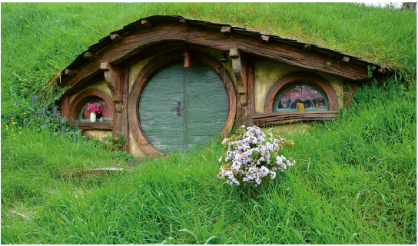
What surprised you the most about the hobbit house?
Would you like to live in one? Why? Why not?

Slide 11
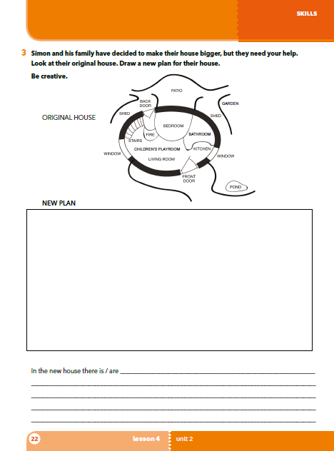
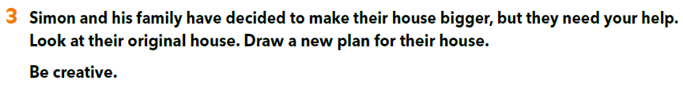
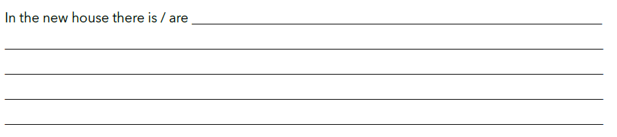
PROJECT TIME!
Open your workbook on page 22.

Slide 12
Present your project to your classmates!
Whose hobbit house do you like the most? Why?

Slide 13

LEARN MORE.
https://www.e-sfera.hr/dodatni-digitalni-sadrzaji/232891e1-91b4-43f3-b042-67523c52a119/
An Upside Down House
Read the text. Imagine a strange house on your own. Draw a sketch and explain by answering the questions below the text.

